Slide 1

Beyond Utility:
LLMs as Recommenders
A presentation reproducing the framework and exploring the experimental findings of the "LLM as Ranker" phase.

Slide 2


The Motivation
Traditional Models
Large Language Models
Conventional systems are highly data-dependent and evaluated primarily on utility (accuracy, NDCG). They lack robust text-processing abilities and rely heavily on historical user-item interactions and IDs.
LLMs introduce strong zero-shot capabilities, deep textual understanding, and generative power. However, they also bring unique challenges such as candidate position bias and hallucinations that demand new evaluation dimensions.

Slide 3






New Evaluation Dimensions
History Sensitivity
Position Bias
Hallucinations
Analyzing how LLMs perform with varying lengths of input histories. Can they generalize better in cold-start scenarios?
Quantifying the LLM's tendency to prioritize items placed at the beginning of the prompt's candidate list regardless of relevance.
Measuring the frequency at which LLMs fabricate non-existent items, posing a direct threat to recommendation validity.

Slide 4
Phase 1: LLM as Ranker
Experimental Setup and Key Findings from our Reproduction

Slide 5
Reproduction Setup
Category | Details
LLMs Evaluated | GPT-4o, GPT-3.5, Claude 3, Llama 3 (70B), Mistral (7B), Qwen 2 (7B)
Traditional Baselines | MostPop, BM25, BPRMF, GRU4Rec, SASRec, LightGCN
Datasets | Amazon Beauty, Sports & Outdoors, ML-1M, LastFM
Ranking Task Setup | Candidate pools of 1 positive item + 19 negative items. Title-based indexing.

Slide 6


Utility & Novelty Observations
▹
Domain Knowledge Advantage: While generally less accurate than optimal traditional models, LLMs excel in domains where they possess extensive prior knowledge (e.g., LastFM).
▹
Niche Item Discovery: LLMs are significantly less affected by popularity bias. They successfully recommend accurate, long-tail (niche) items.
▹
Generative Profiling: LLM-generated profiles capture key user patterns, enhancing the explainability of the recommendation process.

Slide 7
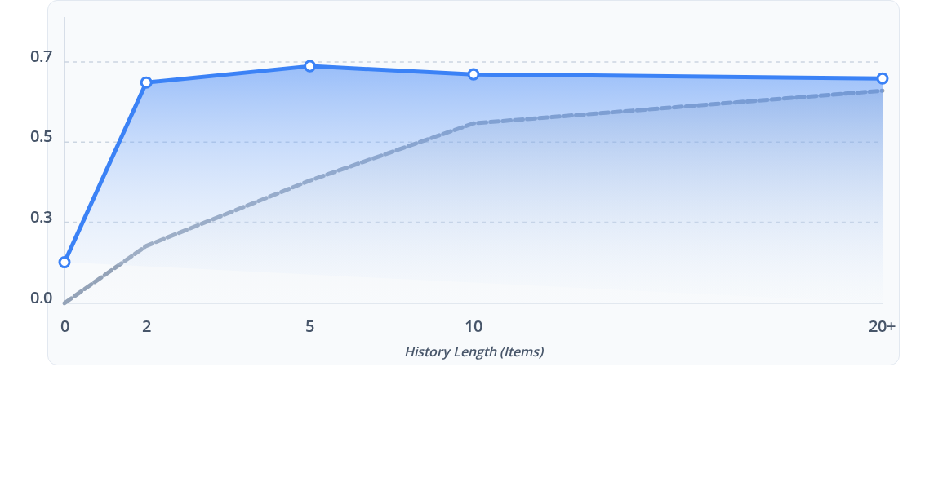
History Length Sensitivity

Slide 8
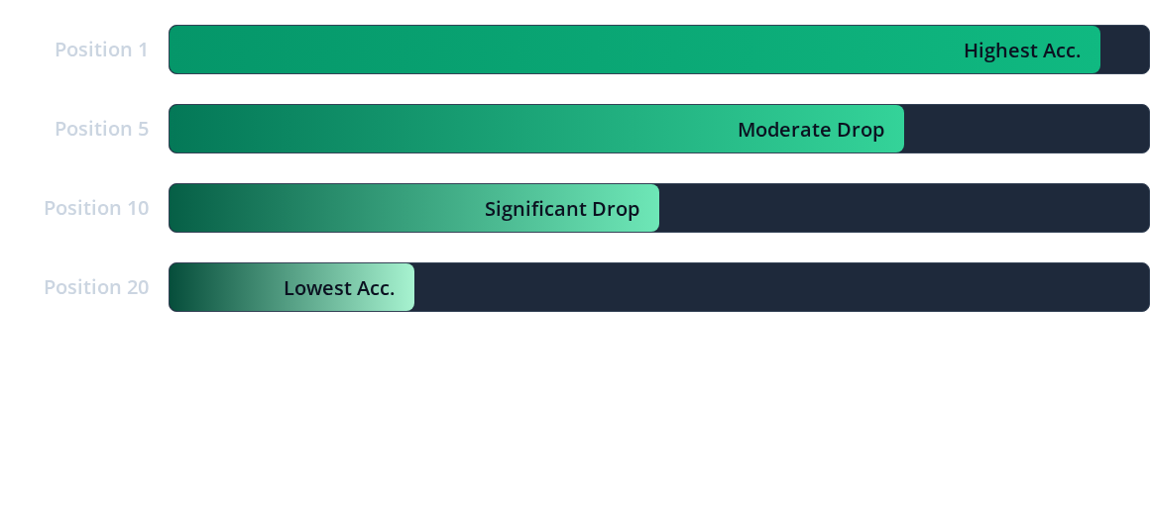
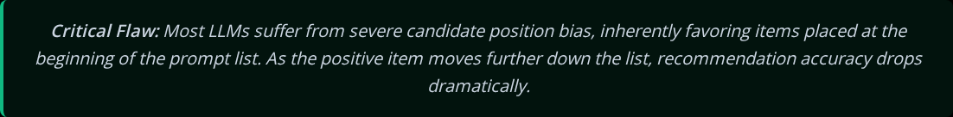
Candidate Position Bias

Slide 9


The Hallucination Problem
Fabricated Recommendations
< 5%
Unlike traditional matrix factorization, generative models can invent items that do not exist in the catalog.
GPT-4o, Claude 3, Llama 3
While models like GPT-4o keep hallucinations below 5%, smaller models like Mistral can generate up to 23% fake items, requiring robust string-matching and mitigation strategies to prevent degraded user experiences.
~ 23%
Mistral 7B (Extreme Case)

Slide 10
Project Status & Next Steps
Step 2
Step 4 (Next)
Traditional Baseline Training (BPRMF, SASRec, etc.)
Evaluating the "LLM as Re-Ranker" Phase
Step 1
Step 3 (Current)
Environment Setup & Dataset Preprocessing
Evaluating the "LLM as Ranker" Phase

Slide 11

Image Sources
https://png.pngtree.com/thumb_back/fh260/background/20260610/pngtree-futuristic-digital-wave-background-with-glowing-data-flow-and-ai-network-image_21911693.webp
Source: pngtree.com

